Slide 1

ANALYSING VISION LOSS IN DIABETIC PATIENTS

Slide 2






Introduction – Team 7
Usama Ather
Anisha Desai
Harshul Garg
Yashwanth Reddy
Esha Kaushal
Hasit Yarlagadda
4.5 years of experience in business consulting & digital marketing analytics
A data-driven professional with 3+ years of diversified experience in finance & consulting
2.5 years of experience as a business analyst in IT consulting and insurance domain
Engineer by training. MBA by choice.
9 years of experience in Technology, Telecom and Banking domains.
Most recent role as the Country Head for a $3 bn credit cards account for a large bank in India
5.5 years of experience in business technology and automation consulting
3.5 years of experience in Technology consulting and Retail analytics

Slide 3

Agenda
Introduction
Diabetes Retinopathy
Dataset Overview
Variables
Aim of study
EDA
Interesting finds in the data
Detailed Analysis
Model fitting
KM Curve
COX Model
Study Conclusion
Takeaways from our analysis
Way forward
Learnings from the study

Slide 4
1.
Introduction
Why are we studying this data?

Slide 5
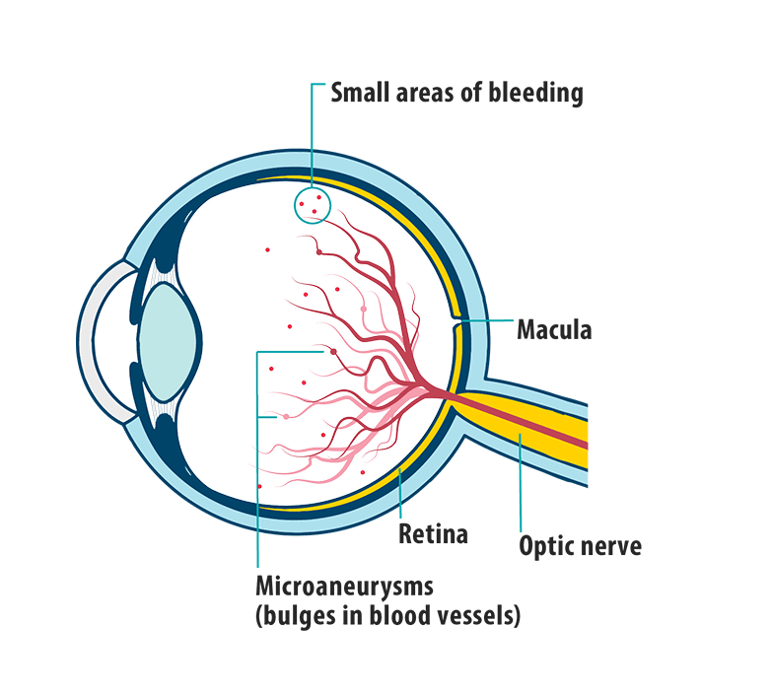
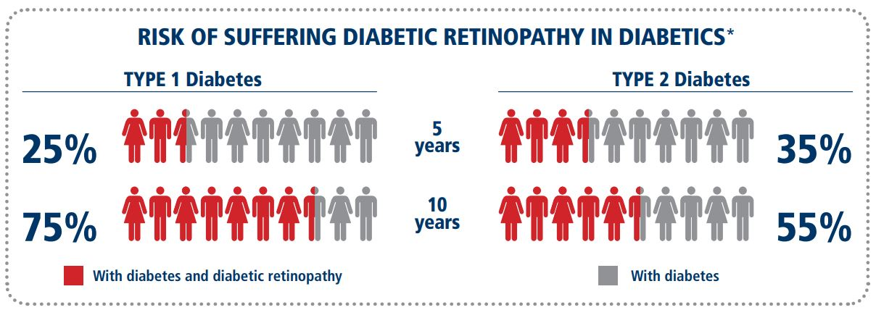
Vision loss due to Diabetic retinopathy
Diabetes is the leading cause of new cases of blindness in people 20 to 74 years of age in the United States
Diabetic retinopathy is a diabetes complication that affects eyes.—but early detection, timely treatment, and appropriate follow-up care may help reduce the severity of the disease.
Risk Factors - Duration and Glycemic control
Notes:
As we all are aware, Diabetes is a disease in which a person’s blood glucose/sugar levels are too high.
Lets see how untreated high blood sugar from diabetes can damage your damages your eyes – Diabetic Retinopathy is the most common diabetic eye disease and can lead to vision loss. It happens when too much blood sugar damages the blood vessels in the retina. As a result the retina doesn’t get enough oxygen & nutrients and blood vessels can leak blood into the retina
Diabetic Retinopathy can get worse over time, particularly if it's not managed. From the chart below….explain
It’s important to remember that early detection and timely treatment can go a long way to reduce the severity of this disease.

Slide 6
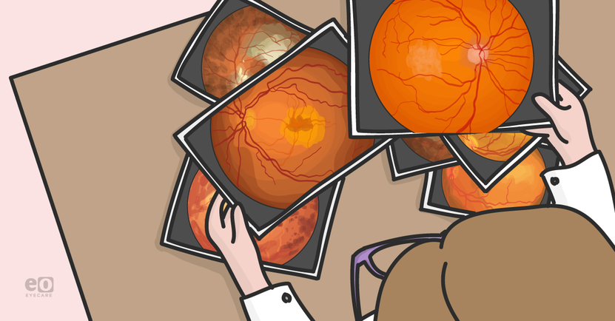
How it relates to our Dataset ?
The Diabetic Retinopathy Study (DRS) began in 1971 to study the effectiveness of laser photocoagulation in delaying the onset of blindness in patients with diabetic retinopathy
Eligible Patients - Patients with diabetic retinopathy in both eyes and visual acuity greater than or equal to 20/100 .
One eye of each patient was randomly selected for treatment and the other eye was observed without treatment.
Initiation of treatment
Visual acuity below 5/200
Time studied in DRS
Notes:
Retinal laser photocoagulation is also used to seal or destroy leaking blood vessels to prevent further retinal damage and preserve sight.

Slide 7
2.
Dataset Overview
What are we studying in the data?

Slide 8

Dataset Overview
Laser:- Laser Type Argon or Xenon
Age:- Age at the time of diagnosis
Eye :- Left or Right Eye
Trt:- Treatment 0 = no , 1= laser treatment
Risk:- Risk Group of 6-12
Time:- Time to event or last follow up
Status:- 0= censored , 1 = visual loss
ID :- Subject ID
Notes:
Risk of diabetes

Slide 9
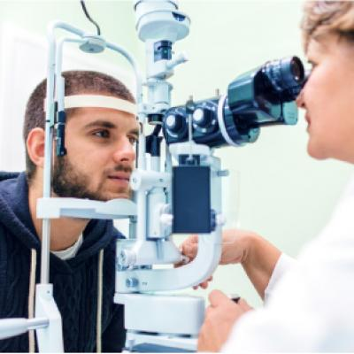
Dataset Overview
The 197 patients in this dataset were a 50% random sample of the patients with "high-risk" diabetic retinopathy.
Each patient had one eye randomized to laser treatment and the other eye received no treatment.
There is a build-in lag time from the initial treatment time to the time when visual acuity dropped. Approx lag of 6 months is considered.
Survival times in this dataset are the actual time to blindness in months, minus the minimum possible time to event.

Slide 10

Dataset Overview
Goal of the analysis is to study- What influences the duration until the event.
Event of study - Visual Loss
The target/response of the study - Time & Status
Available inputs for the study - Laser type, Age, Trt, Risk Level, Eye

Slide 11
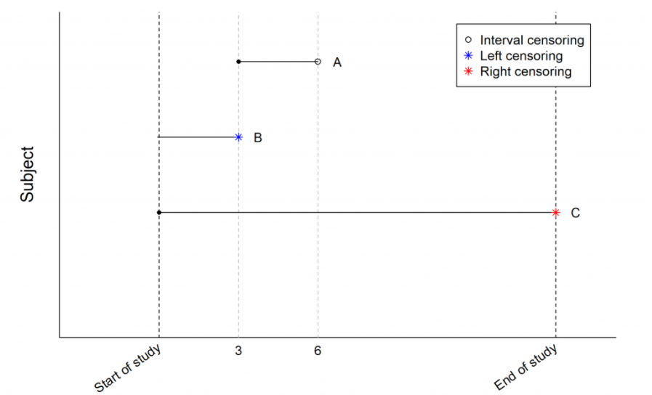
Dataset Overview
Survival Analysis
The primary variable in survival analysis is survival time. The term “survival time” is used loosely for the time period from a starting time point to the occurrence of a certain event. Here our event is visual loss.
Our data is right censored as we only know that a patient’s survival time is more than the time of study. Censoring was caused by death, dropout, or end of the study
Our analysis wishes to interpretive:
Estimate and interpret survival time and risk of an event
Compare survival time/risk between different groups

Slide 12
3.
Exploratory Data Analysis
Interesting finds in the data?

Slide 13
Age Group of Patients in the Dataset
60% of patients in the dataset under the age of 20

Slide 14
Risk Classification
35% of the patients in the dataset in Risk Group 9
Patients in Risk Group 10 have the highest risk of experiencing vision loss

Slide 15
Type of Laser Treatment
Type of Laser | % of Patients
Argon | 42%
Xenon | 58%
Type of Laser used in the treatment is dependent on the age of the patient
Type of Laser | <10 | 11-20 | 21-30 | 31-40 | 41-50 | 51-60 | Total
Argon | 0% | 10% | 100% | 100% | 100% | 100% | 42%
Xenon | 100% | 90% | 0% | 0% | 0% | 0% | 58%

Slide 16
Loss of Vision
~ 20% of patients have experienced loss of vision in both the eyes in patients with age less than 30

Slide 17
Time to Diagnosis of Vision Loss
Have time to diagnosis in case of vision loss in 18.7 months
Age groups <10 and 41-60 have low time to vision loss and need to prioritized in treatment

Slide 18
4.
Survival Analysis
Our analysis using Kaplan-Meier & Cox Proportional Hazard methods

Slide 19
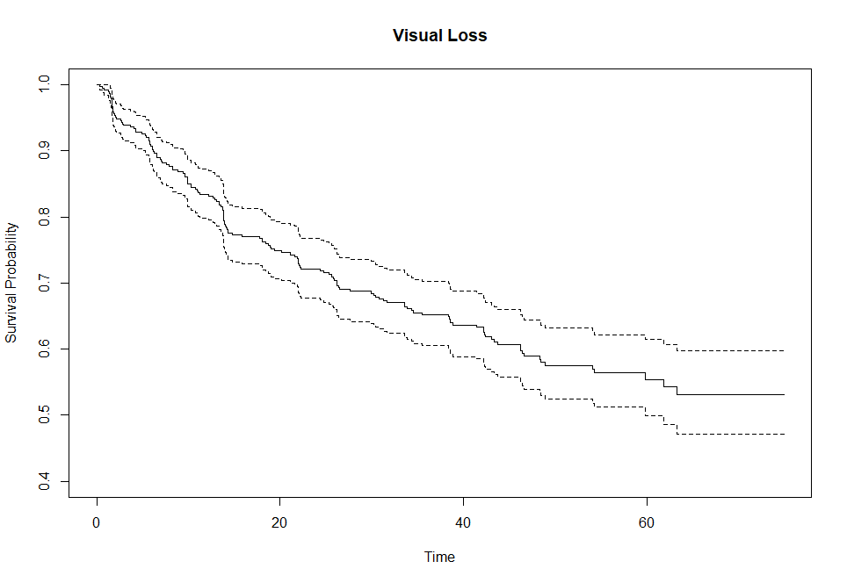
Survival Plot Using All Variables
KM Curve
The curve shows the survival rate to be between ~ 0.47 to 1. S(t) seems to become constant after a certain point (~63).

Slide 20
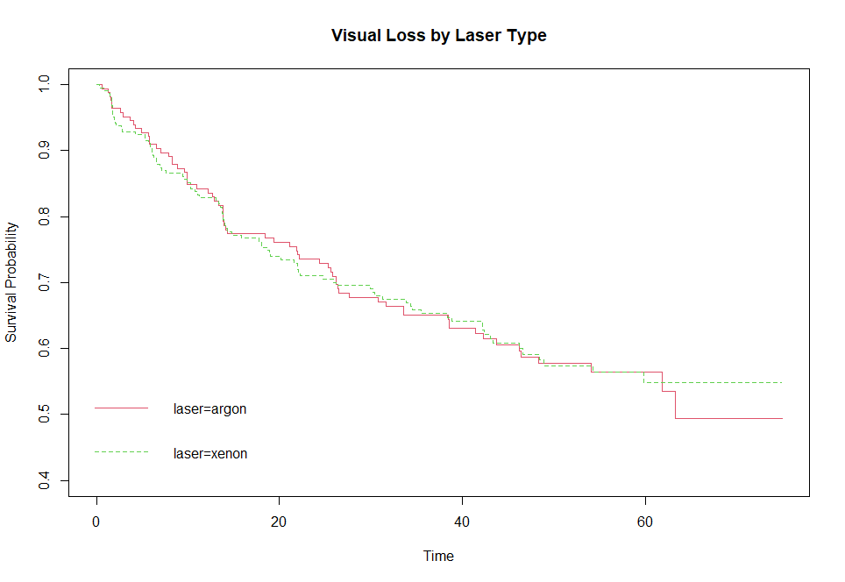
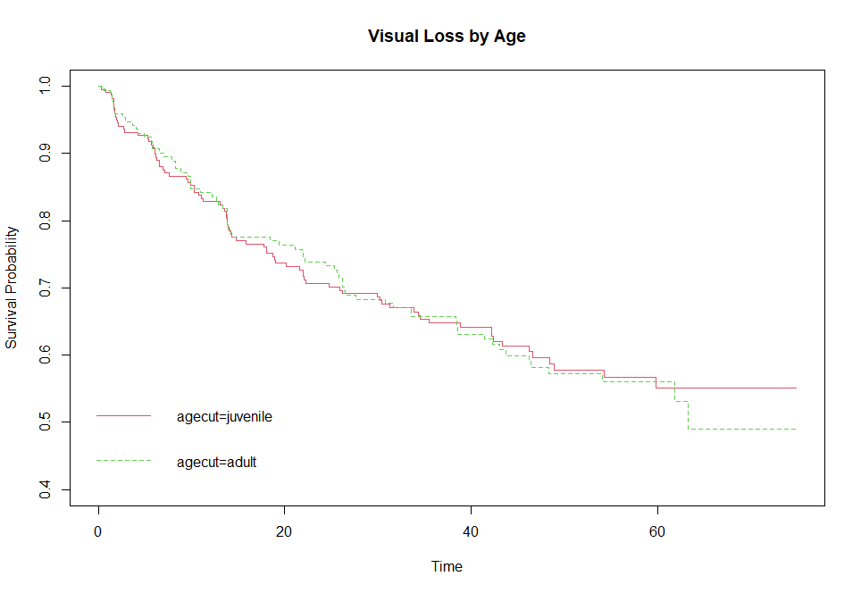
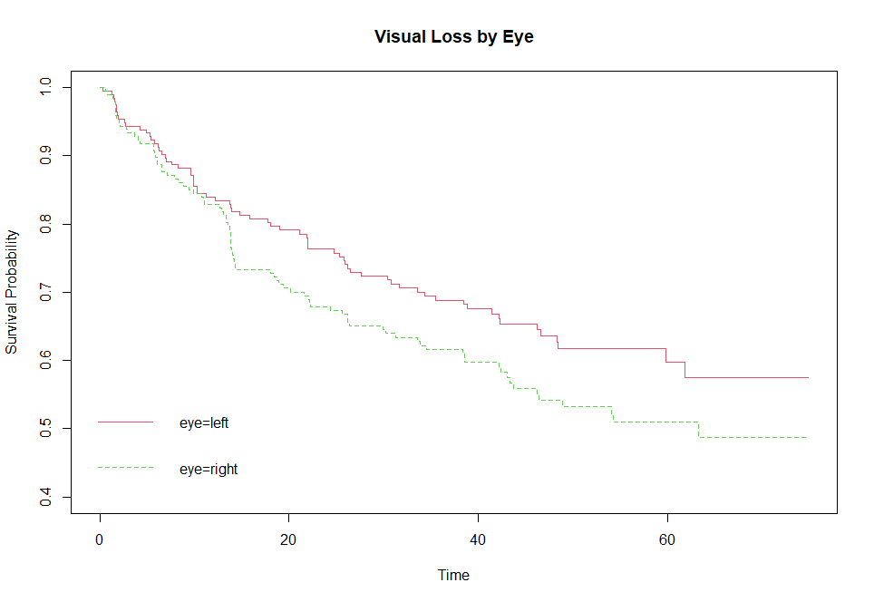
Survival Plot Using Various Variables
Laser Type
Survival rate for both types of laser seem to be similar. However, with a p-value of 0.9 laser isn't a significant predictor.
Age Level
Survival rate for both juvenile & adult seems to be similar with both becoming constant at one point. However, with a p-value of 0.8 age isn't a significant predictor.
Eye Type
Survival rate for left eye seems to be higher but eye is also not a significant predictor with a p-value of 0.08.

Slide 21
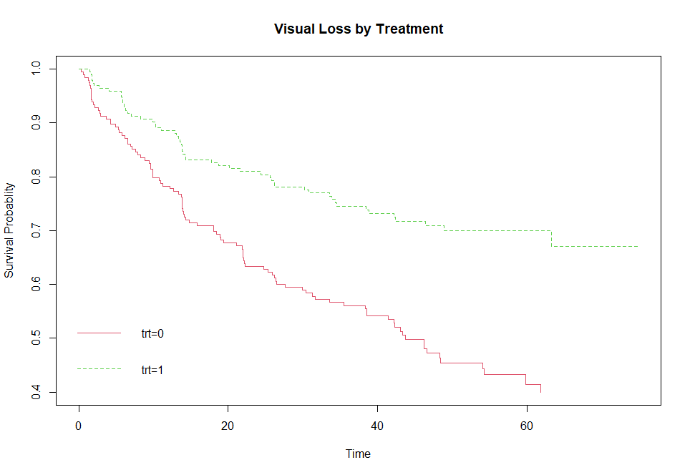
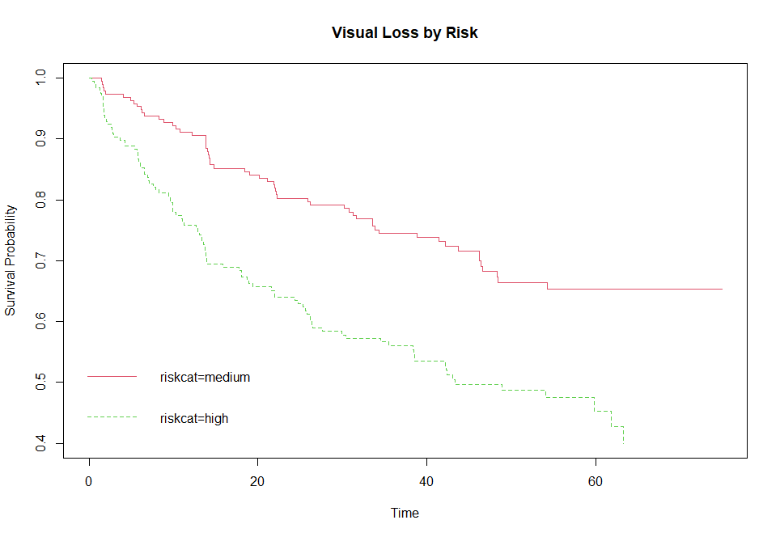
Survival Plot Using Various Variables
Treatment
Survival rate for treatment is drastically higher than no treatment. Also, with a p-value of 2e-06 trt is a significant predictor.
Risk Group
Survival rate for high risk group is lower v. medium risk group. Also, with a p-value of 1e-05 risk is a significant predictor.

Slide 22
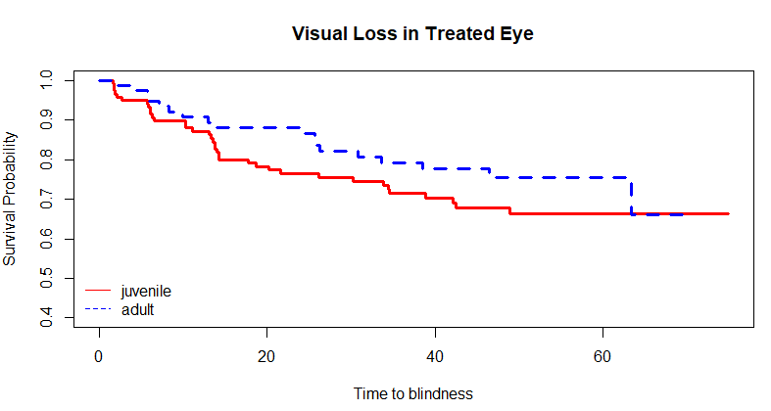
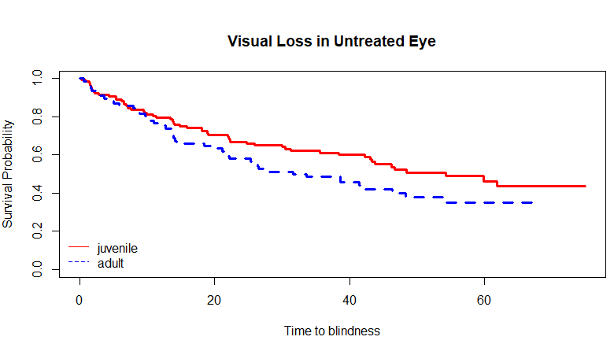
Survival Plot by Type of Diabetes
Treated v. Untreated Eye by Type of Diabetes
Kaplan-Meier survival curves shows the treatment is much more effective for adult onset diabetics than for juvenile onset diabetics. Also, this is a significant predictor with a p-value of 1e-04.

Slide 23
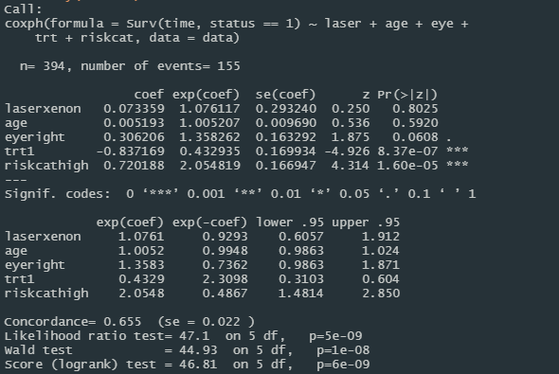
Cox PH Model Results
Overall Results
To predict hazard ratios for our problem
The overall model’s p-value of 5.946e-09 means that the model is meaningful.
Only trt1 & riskcathigh are significant based on p-values
Interpreting exp(coef) we can conclude, compared to the reference variable trt0, trt1 is 0.57x less likely to lose vision
Similarly, riskcathigh is ~1.054x more likely to lose vision as compared to riskcatmedium.

Slide 24
5.
Conclusion
What did we conclude from the study?

Slide 25
Conclusion
Treatment has positive impact on survival time irrespective of the age and laser used.
In adults, this impact of treatment is higher compared to juveniles.

Slide 26
Conclusion
Considering the above data from CDC, the decreased impact of treatment in juveniles might probably be because of the fact that Type-1 diabetes is more difficult to treat compared to Type-2.
Note: We assume that the dataset is a proportional representation of the actual population.
Link for Type 1 and 2 comparison - https://www.cochranelibrary.com/cdsr/doi/10.1002/14651858.CD012314.pub2/full
Link for types of diabetes in adults and juveniles - National Diabetes Statistics Report 2020. Estimates of diabetes and its burden in the United States. (cdc.gov)

Slide 27
6.
Learnings
What did we learn ?

Slide 28
Learnings
Considering potential bias and assumptions required for valid inference
Importance of EDA to identify deeper business insights, like adult vs juvenile
Use of Cox's proportional hazards regression model to the paired-data case ("naturally" paired systems, such as eye)
Importance of study to identify risks and reduce chances of losing vision in high-risk patients with early detection.
Notes:
As with any statistical analysis, attention should be paid to the assumptions required for valid inference, and all relevant information should be gathered to assess potential sources of bias.
For example The so-called lead-time bias is common in studying whether a screening program for a specific disease increases survival time. The Observed pro-longed survival in screened patients could be due to the disease being diagnosed earlier, and not necessarily reflect a benefit of screening on survival time.
Diabetes can be classified into two general groups by the age at onset: juvenile and adult diabetes. Since the two diseases have very different courses, it is desirable to examine how this may affect the time to loss of visual acuity.

Slide 29
7.
Way Forward
What more can be done?

Slide 30
Way Forward
Only information about duration is given but no information about glycemic control
Type of lifestyle of people involved in the study – eg. Smoking status
Demographics
1
3
5
2
4
Information about type of diabeties - type I and Type II
Small data set and lot of censored data (60%)
Notes:
Once retinopathy is present, glycemic control becomes the more important factor in predicting the progression to advanced stages. In general, a HbA1c of 7% or less is recommend for most patients with diabetes., The management of hypertension, as well as lipids, has also been shown to reduce the progression of retinopathy, and delay the need for treatment.
During the first two decades of disease, nearly all patients with type 1 diabetes and >60% of patients with type 2 diabetes have retinopathy.

Slide 31

Thanks!
Any questions?

Slide 32
Age Group of Patients in the Dataset
60% of patients in the dataset under the age of 20

Slide 33
Time to Vision Loss: Heat Map
Age Group
Profile of patients to be monitored:
Risk Factor ‘10’
Age group ’11-20’ and Risk Factor ‘10’
Time to Vision Loss | <10 | 11-20 | 21-30 | 31-40 | 41-50 | 51-60 | Total
6 | 6.3 | 35.1 | 12.2 |  | 30.8 |  | 21.0
8 | 46.2 | 30.1 | 15.2 | 22.0 | 13.9 | 8.8 | 23.2
9 | 23.6 | 18.3 | 26.9 | 9.9 | 13.2 |  | 21.3
10 | 15.9 | 15.8 | 14.7 | 13.5 | 17.3 | 9.8 | 15.2
11 | 16.7 | 18.2 | 42.3 | 30.4 | 24.7 | 54.1 | 22.7
12 | 8.8 | 23.0 |  |  | 12.0 | 6.2 | 14.5
Total | 16.6 | 20.2 | 22.1 | 20.1 | 16.0 | 15.8 | 18.7
Risk Factor
% of Patients | <10 | 11-20 | 21-30 | 31-40 | 41-50 | 51-60 | Total
6 | 1% | 1% | 1% |  | 1% |  | 4%
8 | 1% | 3% | 1% | 1% | 1% | 1% | 7%
9 | 6% | 8% | 8% | 1% | 4% |  | 26%
10 | 9% | 9% | 5% | 3% | 3% | 1% | 30%
11 | 7% | 3% | 1% | 3% | 2% | 1% | 16%
12 | 5% | 6% |  |  | 4% | 1% | 16%
Total | 29% | 30% | 16% | 7% | 14% | 4% | 100%

